Slide 1



ecx.io Frontend Bootcamp — CSS Day 4 13.07.2021.

Slide 2


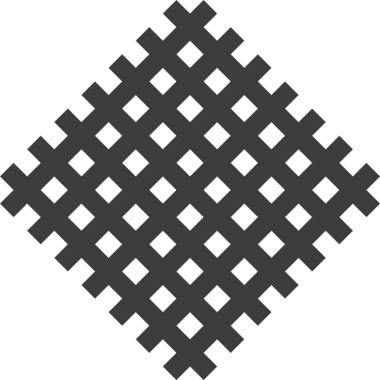
Introduction round

Slide 3
Agenda
Layout
Grid
Positioning
Static
Relative
Absolute
Fixed
Sticky
The stacking context

Slide 4
Grid

Slide 5
Grid
CSS Grid Layout is a two-dimensional layout system for the web.
While flexbox is designed for one-dimensional layout, Grid Layout is designed for two dimensions — lining things up in rows and columns.
Notes:
Most of the time, people especially new ones to CSS, mix Grid and Flexbox, and are not sure when to use which and where.
Both flexbox and grid can sometime solve the same problem. You just need to pick the best one for the job at a given issue or a task.

Slide 6

Grid
Example of using CSS Grid for a photo gallery.

Slide 7
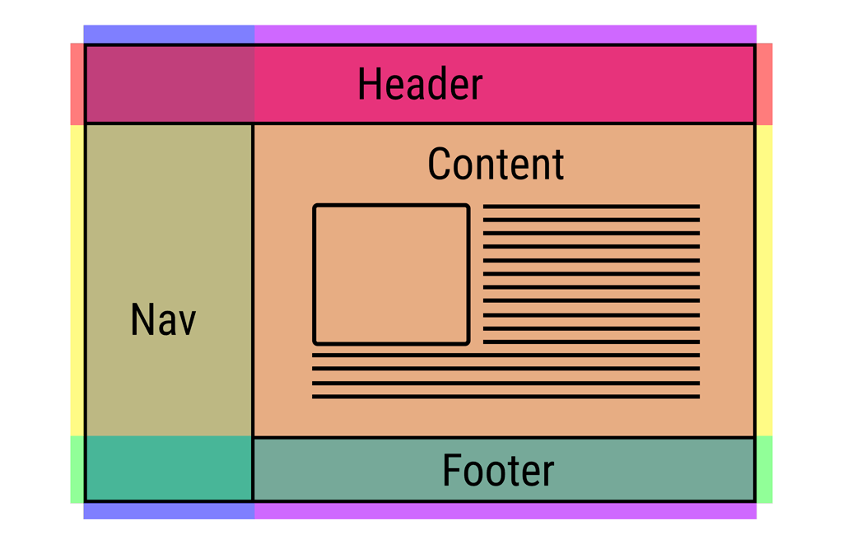
Grid
Or typical layout for most websites.

Slide 8
Grid
Grid Lines
Lines can be horizontal or vertical.
They are referred to by number and can be named.

Slide 9
Grid
Grid Lines
Lines can be horizontal or vertical.
They are referred to by number and can be named.
The highlighted is Column Line 2.
1
2
3
4
Notes:
Grid lines relate to writing mode.
In a right to left language such as Arabic, the first column line is the right-hand line.

Slide 10
Grid
Grid Track
A Grid Track is the space between two Grid Lines.
It can be horizontal or vertical (row/column).

Slide 11
Grid
Grid Track
A Grid Track is the space between two Grid Lines.
It can be horizontal or vertical (row/column).
The highlighted Grid Track is between Row Lines 2 and 3.
1
2
3

Slide 12
Grid
Grid Cell
Smallest unit in our grid.
It’s the space between four Grid Lines.
The highlighted Grid Cell is between row lines 2 and 3, and column lines 1 and 2.

Slide 13
Grid
Grid Area
An area of the Grid bound by 4 Grid Lines. It can contain many Grid Cells.
The highlighted Grid Area is between row lines 1 and 3, column lines 1 and 3.

Slide 14
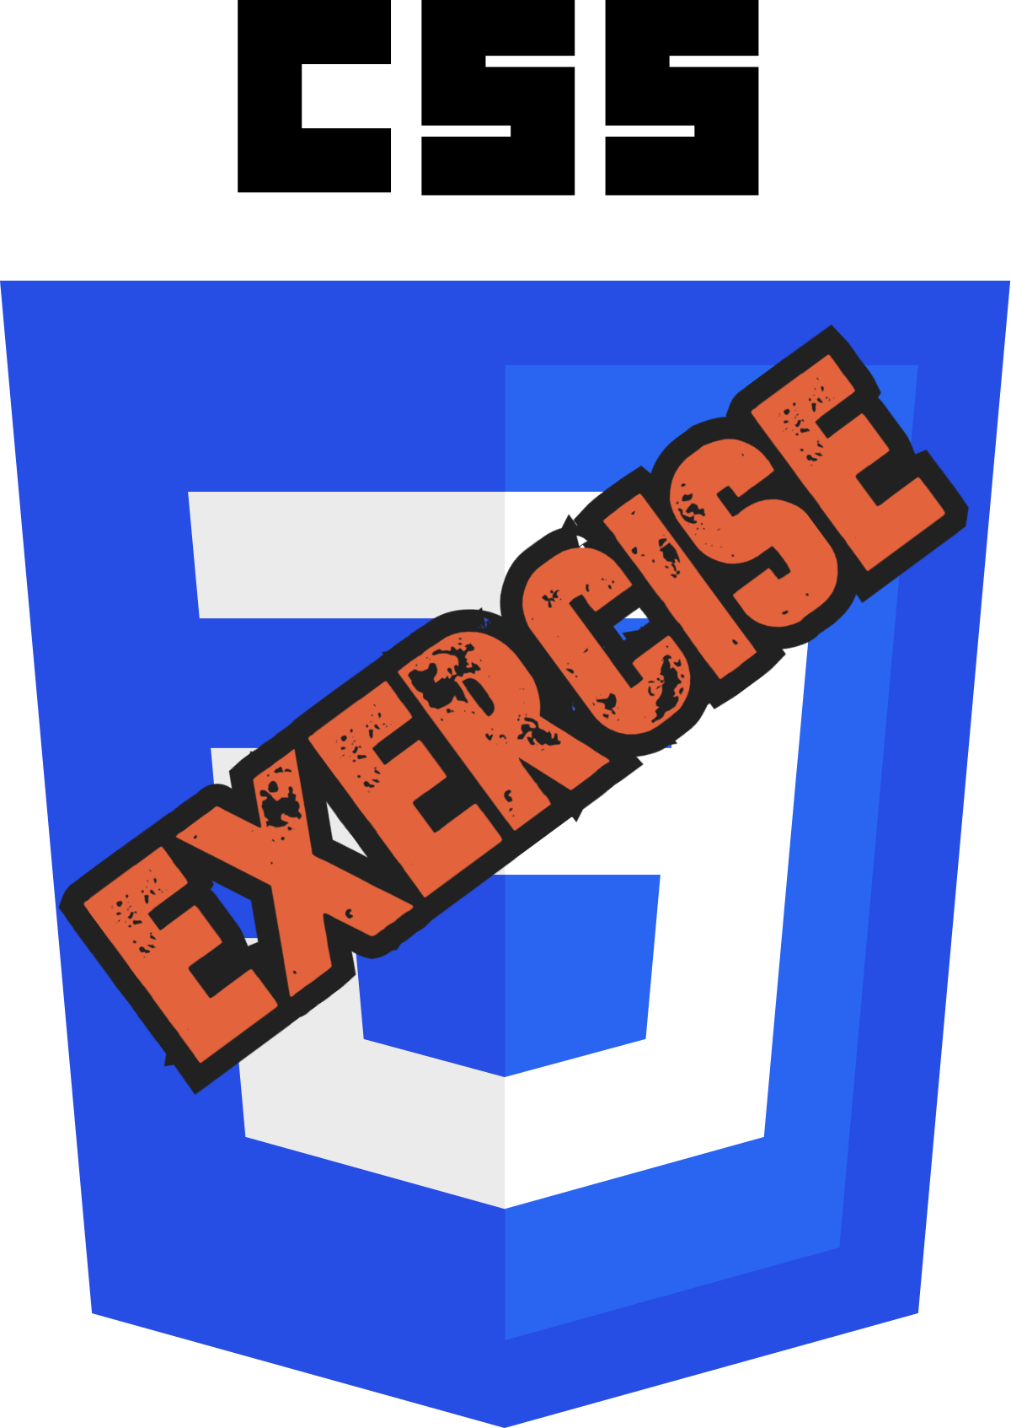
Let’s take a look at Grid in a Browser.
Notes:
Show 1st: stash reference: grid-example-guidelines.md
Show 2nd: stash reference: creating-a-grid-old-way.html
Show 3d: stash reference: creating-a-grid-new-way.html

Slide 15
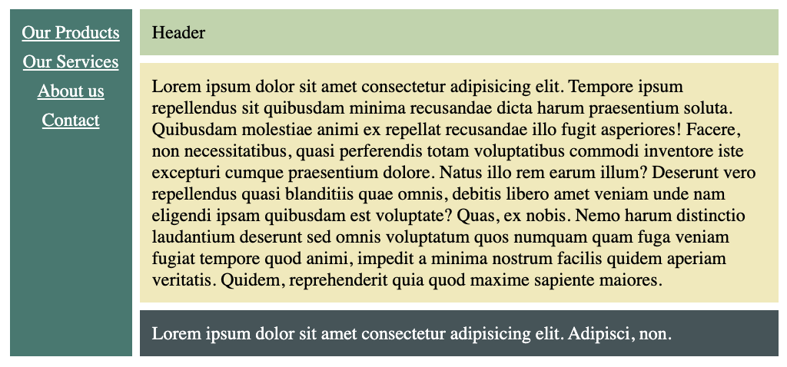
Grid Task 1
Create following layout using CSS Grid and Flexbox
Notes:
30 minutes

Slide 16

Grid Task 2
Create your own 12 column grid system using CSS Grid.
Notes:
20 minutes

Slide 17
Positioning

Slide 18
Static
Default position value.
A static element is said to be not positioned and an element with its position set to anything else is said to be positioned.
Notes:
Other values are: relative, absolute, fixed and sticky.

Slide 19
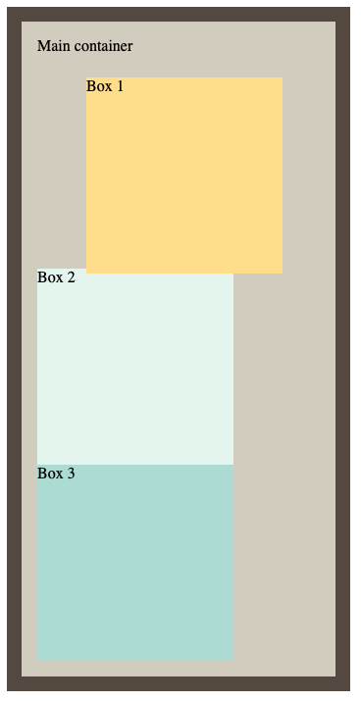
Relative
Same as static.
Has a possibility to move its inset properties.
Used primarily for child elements that are absolute or fixed etc.…
Notes:
We can use inset properties: top, bottom, left and right to move the box relatively from its original position.
It is important to understand that once we set some inset properties, the element is moved out of the document flow and will overflow other elements around it. However, keep in mind that the space for the element is preserved on it's origin position.
In general, we will not use inset properties on relatively positioned element.
For those we will use some other values we have for positioning like `absolute` or `fixed`.
Popular technique for moving element outside of viewport and animating it back in.

Slide 20
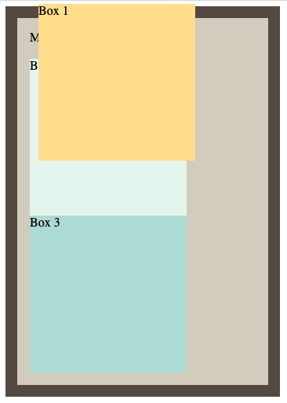
Absolute
Absolute element, absolutely positions itself on 1st parent container that it can reference.
That reference can be any type of positioning other than static.
Element is immediately removed from the document flow.
Notes:
As we set the `absolute` value for position property, element is immediately removed from the document flow.
Browser will also not preserve the space it originally occupied and will ignore the element basically (making other elements in document move up).
We also need to note, that block level element will no longer be block level.
Element will occupy only the space of it's content or more if `inset` properties are set.
Element will be on same position (visually) on the screen.
If we set some inset value, element will move around and might not be where we initially think it would be.
Absolute element, absolutely positions itself on 1st parent container that it can reference (and this where the `relative` value comes in, as relative will not move around).
But, the element does not necessarily needs to be `relative` it can also be any other position value, as long it is not `static`.

Slide 21
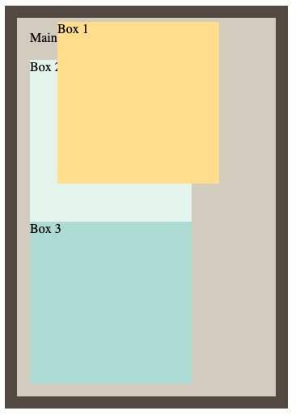
Absolute
Absolute element, absolutely positions itself on 1st parent container that it can reference.
That reference can be any type of positioning other than static.
Element is immediately removed from the document flow.
Notes:
Now with setting position relative on the container element, be aware of the the difference.

Slide 22
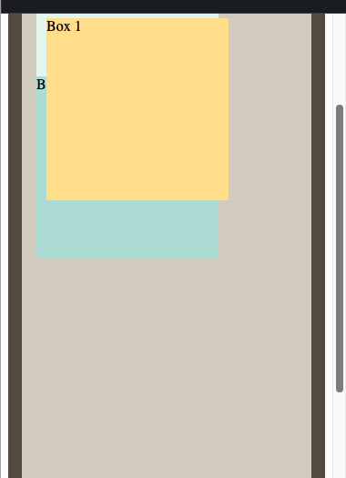
Fixed
Very similar to absolute, but with some caveats.
It is relative to the HTML page.
Fixed element is always on screen, even when we scroll.
Notes:
Element with position value of `fixed` is not relative to any parent.
It is relative to the HTML page. Fixed element is always on screen, even when we scroll.

Slide 23
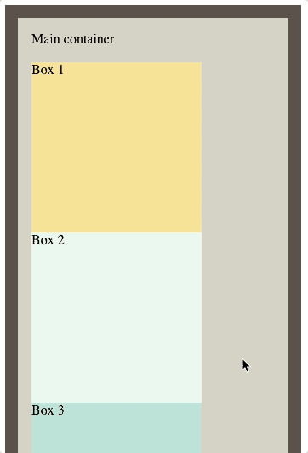
Sticky
Allows us to stick the element on the page and move as we scroll.
It behaves as a relative, but as we begin to scroll and as we move down the page, as soon as the element is about to go away, it changes to fixed position and moves with the page.
Notes:
Allows us to stick the element on the page and move as we scroll.
Basically a combination of `relative` and `fixed` position.
It behaves as a relative, but as we begin to scroll and as we move down the page, as soon as the element is about to go away, it changes to fixed position and moves with the page.
We just need to define one of inset properties, e.g. `top: 0px;`

Slide 24
Let’s take a look at Positioning in a Browser.
Notes:
https://codepen.io/silpap/pen/yLbVGMg

Slide 25
1) Make the 2nd box appear all the way on the right side, but within the same row.
Notes:
https://codepen.io/silpap/pen/yLbVGMg
5min
.box-2 {
position: relative;
left: calc(100% - 200px);
}

Slide 26
3) Make the 1st box appear in top right corner of the container.
Notes:
https://codepen.io/silpap/pen/yLbVGMg
5min
.box-1 {
position: absolute;
top: 5px;
right: 5px;
}

Slide 27
The stacking context

Slide 28
z-index
The z-index property defines the order of the elements on the z-axis.
It works on elements with a position value other than static.
Moving elements to front/back of each other.
Notes:
https://developer.mozilla.org/en-US/docs/Web/CSS/CSS_Positioning/Understanding_z_index/The_stacking_context

Slide 29
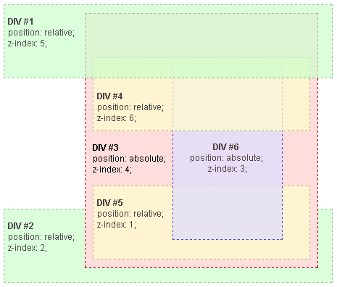
Stacking contexts
It's a parent that contains one or multiple elements.
Those elements will be stacked according to the source order rules, and their z-index values only have meaning within their parent.
Notes:
Explain in short how it works and how elements are grouped really.
More in depth explanation is not required at this time.

Slide 30
Reference links

Slide 31

Reference links
Grid
https://developer.mozilla.org/en-US/docs/Learn/CSS/CSS_layout/Grids
https://css-tricks.com/snippets/css/complete-guide-grid/
https://learncssgrid.com/
https://gridbyexample.com/
Positioning
https://developer.mozilla.org/en-US/docs/Learn/CSS/CSS_layout/Positioning
https://developer.mozilla.org/en-US/docs/Web/CSS/position
https://css-tricks.com/almanac/properties/p/position/
https://developer.mozilla.org/en-US/docs/Web/CSS/CSS_Positioning/Understanding_z_index/The_stacking_context

